Slide 1
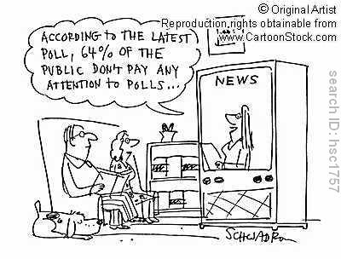
Producing Data
http://www.cartoonstock.com/directory/d/data_gathering.asp

Slide 2
Sources of Data - Goals
Identify anecdotal data in a specific situation and explain why we should not use this type of data.
Define what is meant by available data.
Distinguish between experiments and observational studies.

Slide 3
Anecdotal Data and Available Data
Anecdotal data represent individual cases that often come to our attention because they are striking in some way.
Available data are data that were produced in the past for some other purpose but that may help answer a present question inexpensively. The library and the Internet are sources of available data.

Slide 4
Observational Studies and Experiments
In an experimental study, we investigate the effects of certain conditions on individuals or objects in the sample.
In an observational study, we observe the response for a specific variable for each individual or object.

Slide 5
Designing Experiments and Observational Studies - Goals
In experiments, identify the units or subjects, treatments or factors and outcomes.
Identify a comparative experiment and explain why they are used.
Be able to apply the basic principles of experimental design: compare, randomize and repeat.
Be able to identify common problems in design:
Bias
Over generalization
Be able to identify matched pairs design and block design and explain why they are used.

Slide 6
Terms used in experiments
Experimental units
Treatment or factor
Level
Outcome
Statistically significant
An observed effect so large that it would rarely occur by chance.

Slide 7
Principles of Experimental Design
Control: Compare two or more treatments.
Randomize: use chance to assign experimental units to treatments.
Replication: Use enough experimental units in each group to reduce chance variation in the results.

Slide 8
Comparative Experiments
Experimental units
Treatment
Measure response
Control
Measure response
Compare results
Experimental units
Treatment
Measure response

Slide 9
Randomized Experiments
In a completely randomized design, the treatments are assigned to all the experimental units completely by chance.
Group 1
Treatment 1
Compare results
Experimental units
Random assignment
Group 2
Treatment 2

Slide 10
Other Designs
A matched pair design is when each experimental unit is matched with another one.
A block is a group of experimental units that are similar.
In a block design, the random assignment of experimental units to treatments is carried out within each block.
Control what you can, block what you can’t control, and randomize to create comparable groups.

Slide 11
Sampling Design - Goals
Be able to determine and explain when a probability sample, simple random sample or a stratified random sample is the preferred method.
Be able to state when there is a response bias with obtaining a sample: convenience sample, nonresponse

Slide 12
Sampling Methods
Probability Sample – Random Samples
Simple Random Sample (SRS) - A (simple) random sample (SRS) of size n is a sample selected in such a way that every possible sample of size n has the same chance of being selected.
Stratified Random Sample – 1) divide into groups, 2) SRS

Slide 13
Bias
The design of a study is biased if it systematically favors certain outcomes.
Convenience sample
Undercoverage
Nonresponse
Your random sample needs to be representative of the population.
Be careful about over generalization.

Slide 14
Managing Bias and Variability
To reduce bias, use random sampling.
To reduce variability of a statistic from an SRS, use a larger sample

Slide 15
Statistical Inference
Sample has to be representative of the population
Randomize
The experiment has to be performed in such a way that you can obtain the data that you are interested in.
Perform the correct analysis.

Slide 16
Causality - Goals
Be able to determine if a variable is lurking or confounding.
Be able to explain an association in terms of
Causation
Common response
Confounding variables
Apply the criteria for establishing causation.
Association and causation are NOT the same thing.
Interpret examples in terms of Simpson’s paradox.

Slide 17
Causality
A lurking variable is a variable that is not among the explanatory or response variables in a study but that may influence the variables in the study.
Confounding occurs when two variables are associated in such a way that their effects on a response variable cannot be distinguished from each other.

Slide 18
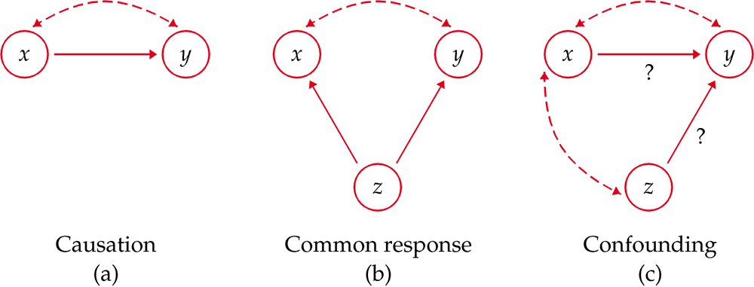
Causation
Association does not mean causation!

Slide 19
Provide All the Critical Information
Papers reporting scientific research are supposed to be short, with no extra baggage. Brevity, however, can allow researchers to avoid complete honesty about their data. Did they choose their subjects in a biased way? Did they report data on only some of their subjects? Did they try several statistical analyses and report only the ones that looked best? The statistician John Bailar screened more than 4000 medical papers in more than a decade as consultant to the New England Journal of Medicine. He says, “When it came to the statistical review, it was often clear that critical information was lacking, and the gaps nearly always had the practical effect of making the authors’ conclusions look stronger than they should have.” The situation is no doubt worse in fields that screen published work less carefully.

